Slide 1

Department of CE/IT/AI
Computer Programming (01CE1101)
Unit - 1
Introduction

Slide 2
Computer
What is Computer…?
A Computer is Electronic device that can
accept data,
store data,
retrieve the stored data
process data as desired and when required
output the result in desired format.
A computer can be defined as a fast electronic calculating machine that accepts the (data) digitized input information process it as per the list of internally stored instructions and produces the resulting information.

Slide 3
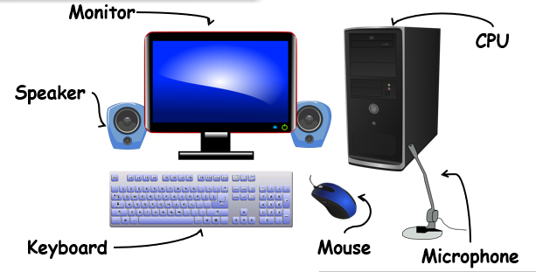
Hardware
Hardware is a physical parts computer that cause processing of data.

Slide 4
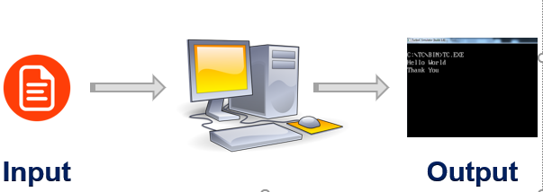
Software
A computer software is a set of instructions for a computer to perform a specific task.

Slide 5
Characteristics of Computer
Computer is fast and accurate electronic system that is designed to accept and store input data, process them and produce output results using the instructions of a stored program.
Speed: Computer executes one instruction at a time. Most instructions are carried out in less than a millionth of a second.
Accuracy: Since the circuits in a computer have electronic parts, which far do not have wear and tear, the instructions are carried out without any mistakes.
Vast Storage Media: In a computerized system a very large amount of data can be stored.

Slide 6
Applications of Computer
Entertainment( Gaming, Movies, etc.)
Communication
Text (word) Processing
Image Processing
Voice Recognition
Numerical and Data Processing

Slide 7
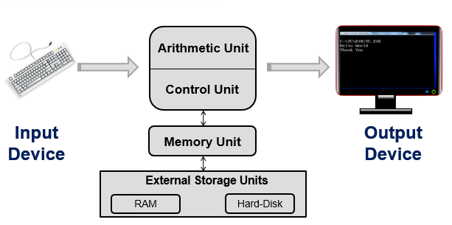

Block diagram of computer

Slide 8
Block diagram of computer
A Computer has four main components. They are
Central Processing Unit
Memory Unit
Input devices
Output devices

Slide 9
Central Processing Unit(CPU)
The CPU acts as the computer brain. CPU is responsible for the overall working of all components of the computer.
It consists of two parts:
Arithmetic and Logic Unit
Control Unit
The ALU performs arithmetic operations and conducts the comparison of information for logical decisions.
The control unit is responsible for sending /receiving the control signals from / to all components.
Under the control of CU, the data comes from input device(s) to memory, it is processed in ALU and the result is stored back in the memory. The processed results are displayed with the help of an output device.

Slide 10
Memory Unit
The memory unit of the computer is used to store data, instructions for processing data, intermediate results for processing and the final processed information.
The memory of the computer of two types:
Primary Memory
Secondary Memory

Slide 11
Primary Memory
Primary memory is faster in speed, less in size (normally a few megabytes) and costlier.
It consists of
ROM (Read Only Memory)
RAM (Random Access Memory)
ROM – In ROM, the information is pre-recorded into the ROM chip at manufacturing time.
It stores data and instructions, even when the computer is turned off. It is the permanent memory of the computer where the contents cannot be modified by an end user.
ROM is called non-volatile memory because it never loses its contents.

Slide 12
Primary Memory
ROM holds instructions that the computer needs to operate.
ROM stores critical programs such as the program that boots the computer.
Programmable Read Only Memory - PROM
Erasable Programmable Read Only Memory - EPROM
Electrically Erasable Programmable Read Only Memory - EEPROM

Slide 13
Primary Memory
RAM- It contains all types of intermediate and temporary data to be used by the CPU.
In fact, CPU can work / process only that data which is present in the RAM.
Any data present in the secondary memory needs to be first brought to RAM and only then can it be used by the CPU.
Since data can be both written to and read from this memory it is called Read/Write memory.
RAM is volatile, meaning that it loses its contents when the computer is turn off or if there is a power failure.

Slide 14
Secondary Memory
Secondary memory is usually a very large amount of memory (in gigabytes), which is comparatively cheaper and slower than primary memory, but is permanent in nature.
Thus, anything stored in secondary memory remains available even if the computer is switched off.

Slide 15
Input Devices
Input devices accept data and instructions from the user or from another computer system.
The most common input devices are
Keyboard
Mouse
Scanner
Joy stick
Microphone
Optical Character Reader(OCR)

Slide 16
Output Devices
Output devices return processed data to the user or to another computer system.
The most commonly used output devices are
Monitor
Printer
Speakers
Plotters

Slide 17
Languages
Programming is a creative process done by programmers to instruct a computer on how to do a task.
Why Programming Language?
A programming language is a formal constructed language designed to communicate instructions to a machine, particularly a computer.

Slide 18
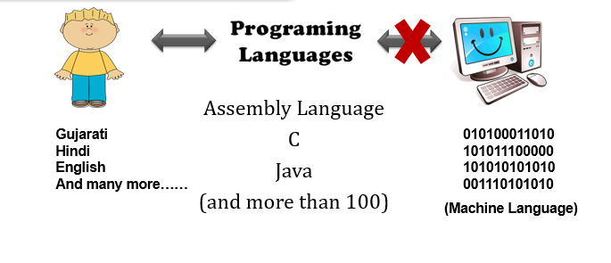
Languages

Slide 19
Languages
The operations of computer are controlled by a set of instructions called a computer program. These instructions are written to tell the computer:
What operation to perform
Where to locate data
How to represent results
When to make certain decisions
The communication between two parties, whether they are machines or human beings, always needs a common language or terminology.
The language used in the communication of computer instructions is known as the programming language.

Slide 20
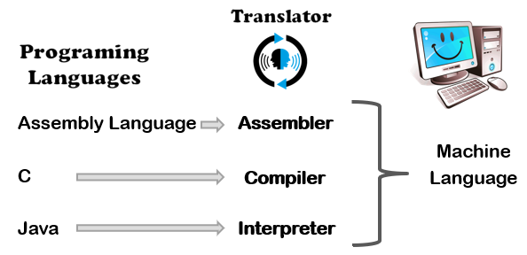
Languages

Slide 21
Languages
Programing
Languages
.model small
.data
opr1 dw 1234h
opr2 dw 0002h
.code
mov ax,@data
mov ds,ax
mov ax,opr1
mov bx,opr2
clc
add ax,bx
mov di,offset result
mov [di], ax
mov ah,09h
mov dx,offset result
end
Assembly Language
C
Java

Slide 22
Languages
Programing
Languages
Assembly Language
C
Java
void main()
{
int opr1,opr2;
opr1=4660;
opr2=2;
result=opr1+opr2;
}

Slide 23
Languages
Programing
Languages
Assembly Language
C
Java
class Sum
{
public static void main(String arg[])
{
int opr1,opr2;
opr1=4660;
opr2=2;
result=opr1+opr2;
}
}

Slide 24
Languages
So for as programming language concern these are of two types.
1) Low level language
2) High level language
Low level language:
Low level languages are machine level and assembly level language.
In machine level language computer only understand digital numbers i.e. in the form of 0 and 1.
So, instruction given to the computer is in the form binary digit, which is difficult to implement instruction in binary code.

Slide 25
Language
This type of program is not portable, difficult to maintain and also error prone.
The assembly language is on other hand modified version of machine level language. Where instructions are given in English like word as ADD, SUM, MOV etc. It is easy to write and understand but not understand by the machine.
So, the translator used here is assembler to translate into machine level. Although language is bit easier, programmer has to know low level details related to low level language.
In the assembly level language, the data are stored in the computer register, which varies for different computer. Hence it is not portable.

Slide 26
Language
High level language:
These languages are machine independent, means it is portable. The language in this category is Pascal, Cobol, Fortran etc.
High level languages are understood by the machine. So, it need to translate by the translator into machine level.
A translator is software, which is used to translate high level language as well as low level language into machine level language.

Slide 27
Translators
Three types of translator are there:
Compiler
Interpreter
Assembler
Compiler and interpreter are used to convert the high-level language into machine level language.
The program written in high level language is known as source program and the corresponding machine level language program is called as object program.

Slide 28
Translators
Both compiler and interpreter perform the same task but there working is different.
Compiler read the program at-a-time and searches the error and lists them. If the program is error free, then it is converted into object program. When program size is large then compiler is preferred.
Whereas interpreter read only one line or line by line of the source code and convert it to object code. If it check error, statement by statement and hence of take more time.

Slide 29
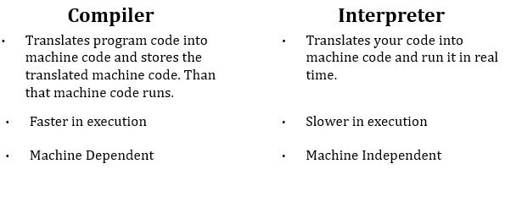
Difference between Compiler and Interpreter

Slide 30
Algorithm
The ordered set of instructions required to solve a problem is known as an algorithm.
Algorithm is a finite sequence of instructions, each of which has a clear meaning and can be performed with a finite amount of effort in a finite length of time.
No matter what the input values may be, an algorithm terminates after executing a finite number of instructions.
We represent an algorithm using a pseudo language that is a combination of the constructs of a programming language together with informal English statements.

Slide 31
Algorithm
Example 1:
Write a Algorithm/pseudo code to add two numbers.
Ans:
Step 1: Start
Step 2:Read the two numbers into a,b
Step 3: c=a+b
Step 4: write/print c
Step 5: Stop.

Slide 32
Algorithm
Example 2:
Write a algorithm to find out number is odd or even?
Ans:
step 1 : start
step 2 : input number
step 3 : rem=number mod 2
step 4 : if rem=0 then print "number even" else print "number odd" endif
step 5 : stop

Slide 33
Algorithm
The characteristics of a good algorithm are:
Precision – the steps are precisely stated (defined).
Uniqueness – results of each step are uniquely defined and only depend on the input and the result of the preceding steps.
Finiteness – the algorithm stops after a finite number of instructions are executed.
Input – the algorithm receives input.
Output – the algorithm produces output.
Generality – the algorithm applies to a set of inputs.

Slide 34
Flow Chart
A Flow chart is a Graphical representation of an Algorithm or a portion of an Algorithm. Flow charts are drawn using certain special purpose symbols such as Rectangles, Diamonds, Ovals and small circles. These symbols are connected by arrows called flow lines.
(or)
The diagrammatic representation of way to solve the given problem is called flow chart.
Flowchart is very helpful in writing program and explaining program to others.

Slide 35
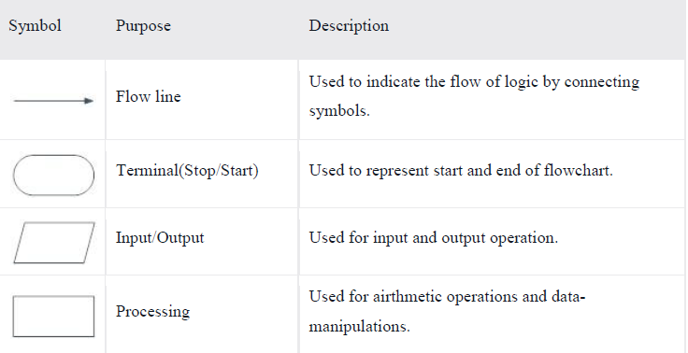
Flow Chart

Slide 36
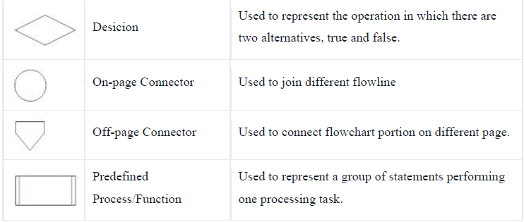
Flow Chart

Slide 37
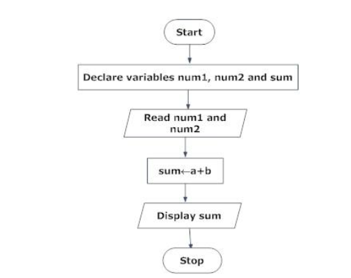
Flowcharts - Examples
Draw a flowchart to add two numbers entered by user.

Slide 38
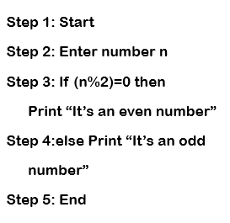
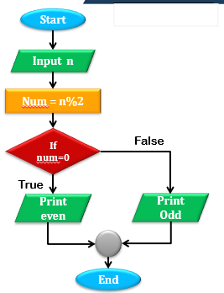
Problem solving using flowchart and algorithm

Slide 39
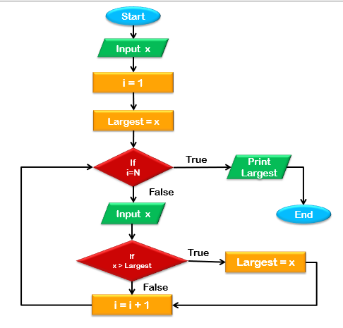
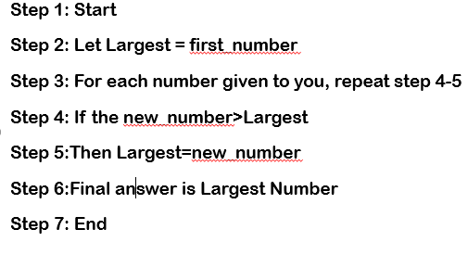
Problem solving using flowchart and algorithm
Example of Finding Largest Number

Slide 40
Number systems
What are the number systems in Computer?
Numbering systems are just symbolic ways to represent the numbers.
Number systems are the technique to represent numbers in the computer system architecture, every value that you are saving or getting into/from computer memory has a defined number system.
Base - A base of a number system (or notation) is the number of symbols that we use to represent the numbers.

Slide 41
Number systems
Different number systems
Binary number system
Octal number system
Decimal number system
Hexadecimal (hex) number system

Slide 42
Binary Number System
A Binary number system has only two digits that are 0 and 1.
Every number (value) represents with 0 and 1 in this number system.
The base of binary number system is 2, because it has only two digits.

Slide 43
Octal number system
Octal number system has only eight (8) digits from 0 to 7.
Every number (value) represents with 0,1,2,3,4,5,6 and 7 in this number system.
The base of octal number system is 8, because it has only 8 digits.

Slide 44
Decimal number system
Decimal number system has only ten (10) digits from 0 to 9.
Every number (value) represents with 0,1,2,3,4,5,6, 7,8 and 9 in this number system.
The base of decimal number system is 10, because it has only 10 digits.

Slide 45
Hexadecimal number system
A Hexadecimal number system has sixteen (16) alphanumeric values from 0 to 9 and A to F.
Every number (value) represents with 0,1,2,3,4,5,6, 7,8,9,A,B,C,D,E and F in this number system.
The base of hexadecimal number system is 16, because it has 16 alphanumeric values.
Here A is 10, B is 11, C is 12, D is 13, E is 14 and F is 15.

Slide 46
Table of number system
Table of the Numbers Systems for C language representation:
Number system | Base | Used digits | Example | C Language assignment
Binary | 2 | 0,1 | (11110000)₂ | int val=0b11110000;
Octal | 8 | 0,1,2,3,4,5,6,7 | (360)₈ | int val=0360;
Decimal | 10 | 0,1,2,3,4,5,6,7,8,9 | (240)₁₀ | int val=240;
Hexadecimal | 16 | 0,1,2,3,4,5,6,7,8,9, A,B,C,D,E,F | (F0)₁₆ | int val=0xF0;

Slide 47
Number System Conversions
Types of conversion:
Decimal Number System to Other Base
Other Base to Decimal Number System
Other Base to Other Base

Slide 48
Decimal Number System to Other Base
To convert Number system from Decimal Number System to Any Other Base is quite easy; you have to follow just two steps:
Step 1 : Divide the Number by the base of target base system in which you want to convert the number: Binary (2), octal (8) and Hexadecimal (16).
Step 2 : Write the remainder from step 1 as a Least Signification Bit (LSB) to Step last as a Most Significant Bit (MSB).

Slide 49
Decimal to Binary Conversion

Slide 50
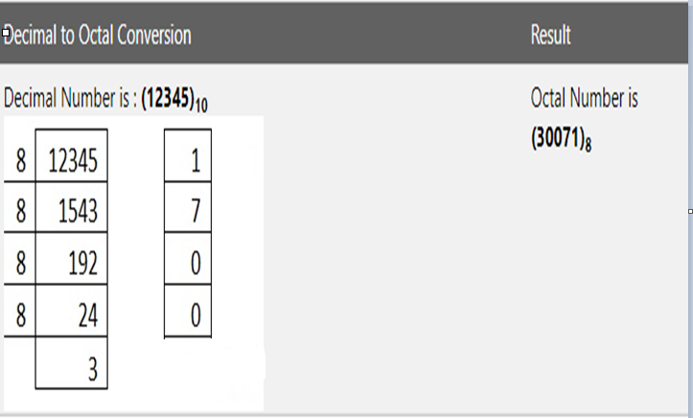
Decimal to Octal Conversion

Slide 51
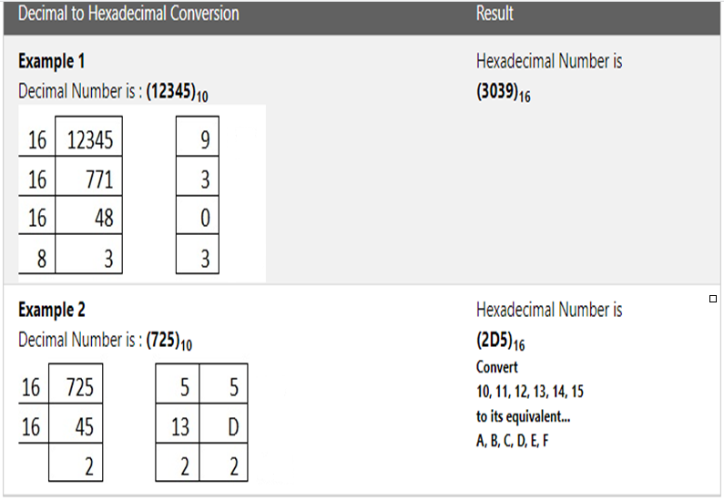
Decimal to Hexadecimal Conversion

Slide 52
Other Base System to Decimal Number Base
Any Other Base System to Decimal Number System, you have to follow just three steps:
Step 1: Determine the base value of source Number System (that you want to convert), and also determine the position of digits from LSB (first digit’s position – 0, second digit’s position – 1 and so on).
Step 2: Multiply each digit with its corresponding multiplication of position value and Base of Source Number System’s Base.
Step 3: Add the resulted value in step-2.

Slide 53
Binary into Decimal Conversion
Example :
Binary number is (10101)₂

Slide 54
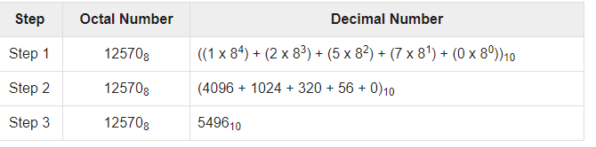

Octal into Decimal Conversion
Example :
Octal number is $(12570)$₈

Slide 55
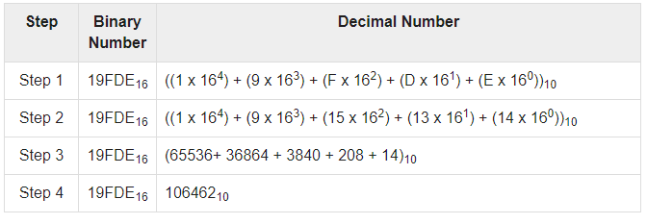
Hexadecimal into Decimal Conversion
Example :
Hexadecimal Number is (19FDE)₁₆

Slide 56
Units of Measurement of data
Bit
It is the smallest unit of memory or instruction that can be given or stored on a computer. A bit is either a 0 or a 1.
Byte
A group of 8 bits called a byte. Combination of bytes comes with various names like the kilobyte, megabyte, gigabyte and terabyte.

Slide 57
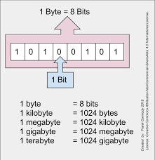
Bits and byte Representation

Slide 58
Thank You!!

